Slide 1
Policy Working Group
27 september 2024

Slide 2
Agenda
Welcome & agenda
EU institutional activities
Institutional renewal update
Draghi report
Hydrogen Bank auctions & Renewable Hydrogen
Low carbon hydrogen delegated act
European support to hydrogen development in Africa
Launch of the Clean Maritime Fuels Platform
Publication of guidelines for the implementation of directives
Opportunities
Data & reports
European Court of Auditors special report on hydrogen
Hydrogen Insights 2024 – Hydrogen Council
Other reports
Notes:
Opportunities – funding and policy

Slide 3
EU INSTITUTIONAL ACTIVITIES

Slide 4
Election EC President and Political Guidelines
Ursula von der Leyen was re-elected president of the EC in July – support of the pro-European 4-party majority in the EP.
Some of her political guidelines:
‘Clean Industrial Deal’ within the first 100 days; to guide investment, particularly in energy-intensive industries such as steel. The Deal should also help to reduce consumers’ energy bills and propose a mechanism of aggregated demand for H2 and for CRM.
‘European Competitiveness Fund’ to be proposed as part of -the post-2027 EU MFF, whose “power to leverage” should make it possible to mobilise “more private and public funding”. This fund will focus on joint cross border projects (IPCEIs)
Notes:
von der Leyen II’ Commission is now “giving way to ‘all-out competitiveness’, which has replaced the ‘Green Deal’” as the Union’s main project.
corresponds in many respects to:
the ‘Clean Technology Deployment Fund’ called for by business leaders.
‘Sovereignty Fund’ call from the European Parliament and a number of countries, including France at the forefront

Slide 5
Proposed new College of Commissioners
On 17 September, the president of the EC allocated portfolios to the the designated candidates Commissioners.
11 women out of 27 Commissionners
6 Executive Vice-Presidents
Next steps:
Examine conflicts of interest
Hearings by the European Parliament
The College is due to take office on 1st December.
Notes:
- 40%-60% gender balance - try to change the process and the rules so that there is an obligation on the part of Member States to propose a male and female candidate” when nominating their candidate Commissioners.
- Possible that the portfolio titles change
Hoekstra / Maltese / Hungarian / Fitto
Slovenian government reconsidering choice of future European Commissioner in response to Ursula von der Leyen’s calls for parity
Resignation of Thierry Breton – following request from von der Leyen
Nicolas Schmit – Spitzenkandidat from the S&D is not accepted by the S&D
Raffaelle Fitto and Olivér Várhelyi, are already on the radar of certain political families.
absence of the candidate heading the list of European Socialists during the European election campaign, Luxembourg's Nicolas Schmit.
Social Affairs turned into Skills portfolio > Social policies are reduced to the fact that people are poorly trained and poorly prepared”

Slide 6
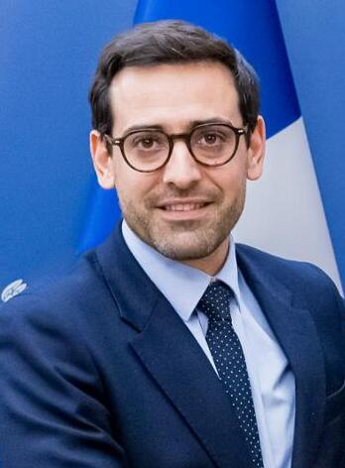
Proposed Commissioner for Startups, Research and Innovation
Ekaterina Zaharieva
Replacing the former Bulgarian Commissioner with a similar portfolio, Iliana Ivanova
Bulgarian
Centre-right party GERB
Experienced politicians but no background on R&I
Separation of the education and research portfolios
The mission Letter includes among other elements:
Expand the EIC and the ERC
Long-term strategy to boost European Research Infrastructure
Advanced Materials Act to support R&I process through to manufacturing and deployment
Work under the guidance of the Executive Vice-President for Prosperity and the Industrial Strategy, with Stéphane Séjourné as Commissioner-designated in this position.
Notes:
The R&D community had been hopeful that someone with an understanding of R&D would become research commissioner, such as the Finland’s Henna Virkkunen, who has a strong track record in research and development.
Long ministerial career

Slide 7
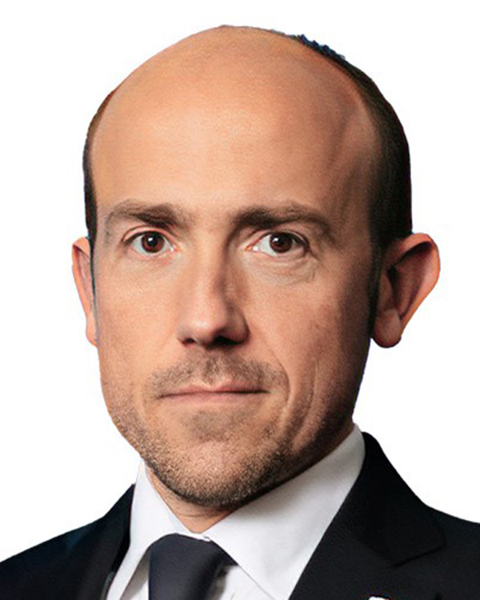
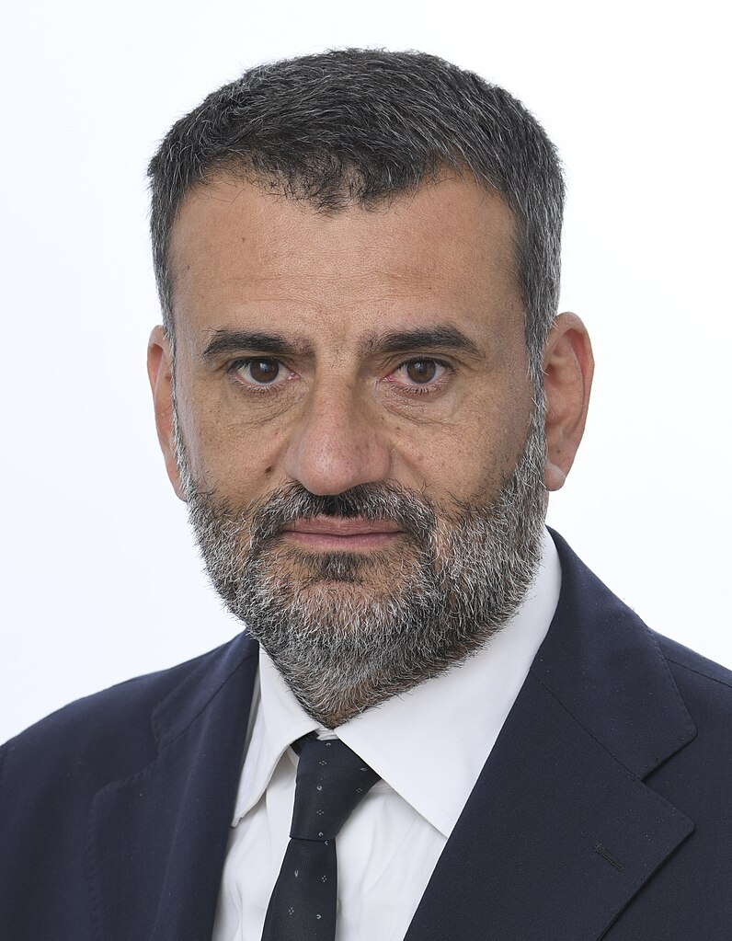
Committees in the European Parliament
ITRE & ENVI Committees are now the two largest of the EP (90 members each) up from respectively 88 and 72 members.
Borys Budka
EPP, PL
Chair of the ITRE Committee
Antonio Decaro
S&D, IT
Chair of the ENVI Committee
Full results of the Committees' elections here. Lists of members and Vice-Chairs for ITRE and for ENVI .
Notes:
The R&D community had been hopeful that someone with an understanding of R&D would become research commissioner, such as the Finland’s Henna Virkkunen, who has a strong track record in research and development.
Long ministerial career

Slide 8
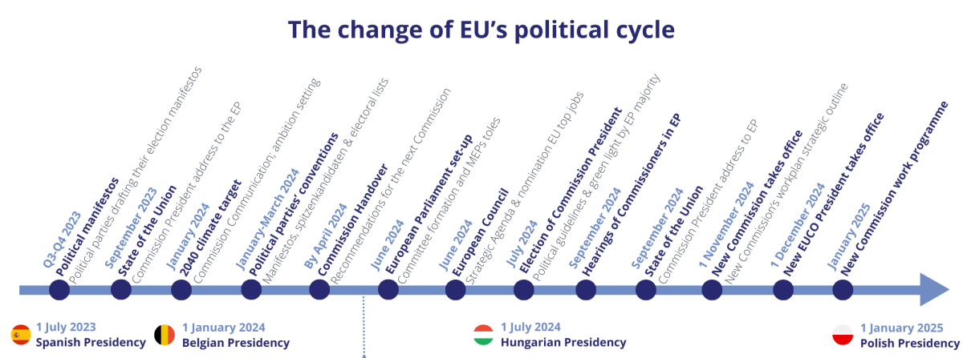
What happens next?
President Ursula von der Leyen elected
TIMELINE DELAYED
https://www.cleanenergywire.org/factsheets/covering-climate-2024-eu-elections-and-making-blocs-next-leadership

Slide 9
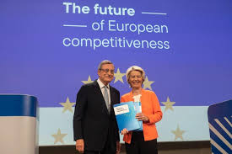
Publication of the Draghi report
Commissionned in 2023 by the EC President Ursula von der Leyen, the report:
Submitted on 9 September
400-page document – 170 recommendations to boost productivity and growth in the EU to be implemented in 10 sectors.
3 main priorities:
bridging the innovation gap in the EU;
developing a plan for decarbonisation and competitiveness;
increasing safety and reducing dependency.
At least €750 to €800 billion of annual investment is needed to achieve the report’s objectives.
Private funding (proposals made)
Public funding to be overhauled – suggest issuing common debt to finance competitiveness and decarbonization objectives; developing a common safe asset.
EU funding schemes:
the MFF “tends to be too fragmented” (50 spending programmes)
Cohesion funds should be better used and injected more into the priorities of digitalisation, transport, education and connectivity.
Notes:
He believes in
Adapting competition rules – for strategic sectors assess of the contribution to resilience and innovation potential (allowing mergers + easily to develop continent scale companies)
Put an end to the State aid temporary crisis framework
Promote IPCEI rather than national aid to support the industry

Slide 10
Publication of the Draghi report
Regarding hydrogen the report:
Recognises the critical role of hydrogen in driving the EU’s green transition and maintaining its industrial leadership
Acknowledges the role of PPP to accelerate technology development.
Highlights hydrogen valleys as drivers of growth in the regions.
Calls for increased investment in green hydrogen production, especially through electrolysis powered by renewable energy sources.
Regarding research and innovation
Suggest the EU create an innovation agency modelled on the American Defense Advanced Research Projects Agency (Darpa)
Horizon Europe “is neither sufficiently funded nor well-structured for the purpose of supporting breakthrough disruptive innovation” – to be created from the EIC budget
Notes:
He believes in
Adapting competition rules – for strategic sectors assess of the contribution to resilience and innovation potential (allowing mergers + easily to develop continent scale companies)
Put an end to the State aid temporary crisis framework
Promote IPCEI rather than national aid to support the industry

Slide 11
Publication of the Draghi report - reactions
MEPs welcomed the report, but are divided on its key recommendations:
shared debt
the need to reduce administrative and regulatory burdens seen as a potential anti-environmental legislation rhetoric.
EU ministers for the Internal market and industry met on 26 September
The EU27 agree on the main points of the ‘Draghi’ report, such as the need to bring down electricity prices and to prioritise efforts in strategic sectors.
Continued disagreement on Mario Draghi’s call for massive investment of private and public money to support industry
Summit on 17/18 October with all head of states where the topic will be on the agenda.
Notes:
He believes in
Adapting competition rules – for strategic sectors assess of the contribution to resilience and innovation potential (allowing mergers + easily to develop continent scale companies)
Put an end to the State aid temporary crisis framework
Promote IPCEI rather than national aid to support the industry

Slide 12
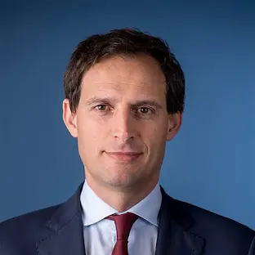
Hydrogen Bank auctions & Renewable Hydrogen
Hydrogen Bank
On 2 September, Wopke Hoekstra speaking to students at Eindhoven University of Technology
Announced that the EC would be proposing internal rules for the next European auction to support hydrogen projects, that should include non-price criteria.
“While the first auction showed that European electrolysers have a good presence, China is now oversupplying them at ever-lower costs. So, I will ensure that the next auction is different” “We will have explicit criteria to build European electrolyser supply chains”
Germany calls for extending transitional rules of renewable H2 production
Germany’s Minister for Economic Affairs, Robert Habeck, sent a letter on 16/09 to the EC calling for an extension of the transitional rules for the production of renewable hydrogen (Delegated Act). The letter:
Questions the temporal correlation criterion - which requires proof of a match between the production of renewable energies on the grid and the production of hydrogen.
“From 1 January 2030, renewable electricity and renewable hydrogen produced from this electricity must be produced within the same hour. We would like to extend the transitional period by one year, until the end of 2030”
Calls for the gradual introduction of “additionality” standards until 2035 (instead of 2030) – would make it possible to support companies facing high project costs

Slide 13
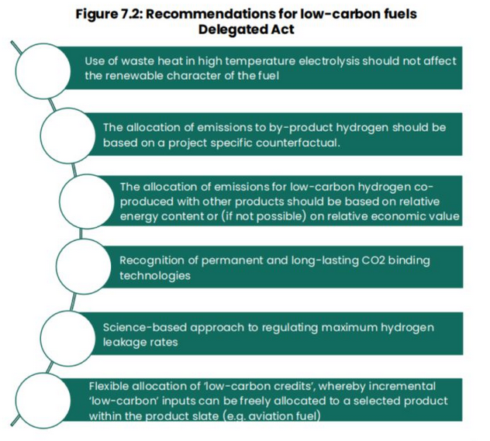
Low carbon hydrogen delegated act
The publication of the low carbon hydrogen delegated act is still awaited. Several organisations have shared their views on what it should include.
Hydrogen Europe – quarterly magazine
Nucleareurope - letter
calling for “accurate emission factor for nuclear electricity” more recent data to be used to indicate the “generic upstream emission factor” for nuclear electricity
recognising a specific carbon content for power purchase agreements (PPAs) for nuclear power, which differs from the grid average
covering all relevant sourcing options for electrolysers producing RFNBOs, including direct connections to nuclear power plants.
American Chamber of Commerce – position paper calling:
to build on the European Hydrogen Bank and simplify the various support mechanisms in place in the EU for H2 technologies
to support a technology-neutral approach (focusing on carbon intensity not production methods)
to enhance international collaboration (transatlantic) to access lower-cost low carbon energy sources, standardise certifications, share best practices and establish international hydrogen trade routes
Notes:
For AmCham EU, it is indeed important to take into account carbon intensity “and not the colour of hydrogen” when considering support f
transatlantic collaboration offers European industry “an excellent opportunity” to access cheaper, low-carbon energy sources f
insists on strengthening international cooperation on standards, cross-recognition of certification methods and the sharing of best practice from the US.or projects and technologies.
Any views from attendees on the DA on low carbon H2?
1. develop certification mechanisms (and a compliant regulation) for hybrid technology solutions (e.g., reversible electrolysers/FCs that could work either with Renewables or Fossil fuels with CCS (or other options meeting the requirements of the Delegated atc)
2. point 1 could open the way for R&I on hybrid/reversible technologies that today are still at a low TRL
3. involve demo projects and scaling up solutions for demonstrating and validating that they are within the border of the delegated act

Slide 14
European support to hydrogen development in Africa
Ex-Commissioner for Energy, Kadri Simson was travelling to South Africa and Namibia in September
Participation in the Global African Hydrogen Summit in Namibia on 4 September
During the Summit, the EU launched 3 EU-funded programmes in Namibia:
Support Namibian and South African green hydrogen investment funds to the tune of €50 million.
Mobilise, with Germany, €2.7 million as part of the Eu-Get.transform programme to support energy planning and to help Namibia develop its renewable energy production capacity, particularly in remote areas.
Provide €1.2 million for Namibia’s green hydrogen programme, also supported by Germany and the Netherlands
The EC is due to launch a platform to match demand for green hydrogen with international producers by mid-2025. Commissioner Simson sketched out the contours of a ‘match-making platform’ to match European demand with green hydrogen producers around the world.

Slide 15
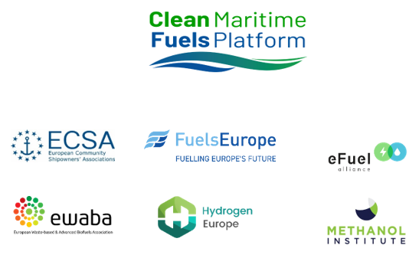
Launch of the Clean Maritime Fuels Platform
On 12 September, 6 associations launched a clean maritime fuels platform - the European Community Shipowners’ Associations (ECSA), the European Fuel Manufacturers (FuelsEurope), the eFuel Alliance, the European Waste-based and Advanced Biofuels Association (EWABA), HydrogenEurope and the Methanol Institute
“A bottom-up industry initiative aiming to enhance communication between the shipping sector and fuel producers and to identify common challenges and possible solutions, considering the implementation of the ‘Fit for 55’ legislative package and the transition to a net-zero economy by 2050”
The platform will focus on policies and tools to support the production and uptake of clean marine fuels in Europe, including areas such as marine fuels in the European Emissions Trading Scheme and funding opportunities.

Slide 16
Publication of guidelines for the implementation of directives
Guidelines adopted by the EC to facilitate implementation of ‘renewable energy’ RED) ‘energy efficiency’ directives.
Energy system integration – electricity network operator will have to provide almost real-time information on the proportion of renewable energy and GHG emissions content of the electricity supplied to end-users.
RFNBOs – include a calculation of the targets for the consumption of RFNBOs and their scope, as well as the link between the target for industry and that for transport.
Heating and Cooling – clarify the accounting for higher share of renewable energy in this sector, as well as how to apply the definition of waste heat.
Energy Efficiency Directive – detail how to establish planning obligations for systems that do not meet the criteria for ‘efficient’ district heating and cooling systems; explain how to make efficient use of the surplus heat available in energy-intensive installations.

Slide 17
OPPORTUNITIES

Slide 18
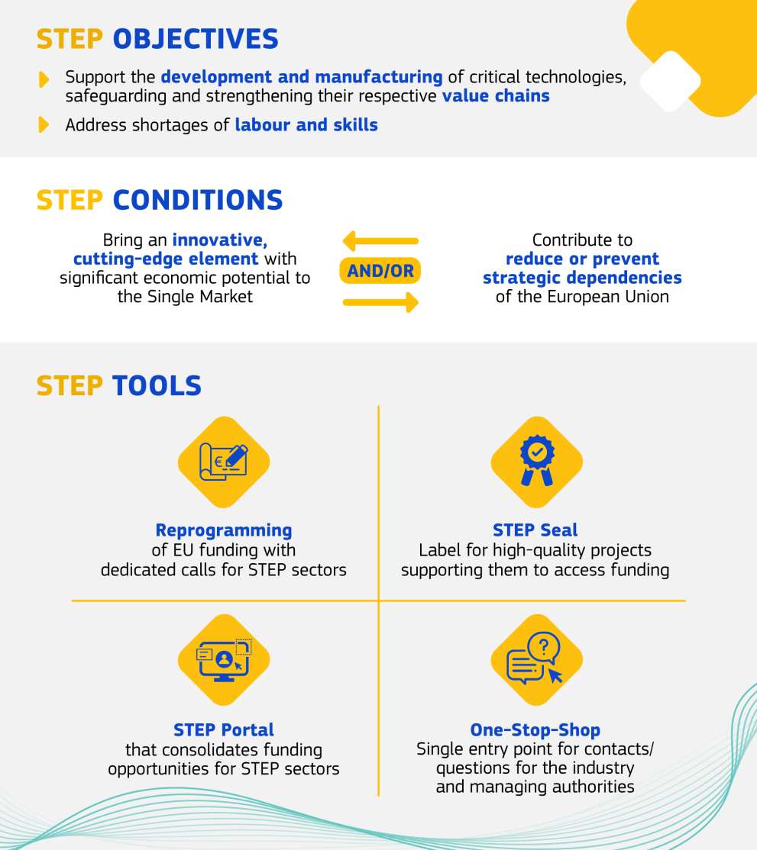
Launch of the STEP one stop shop
Strategic Technologies for Europe Platform – STEP adopted with the Net Zero Industry Act
Launch of the online portal giving project promoters, investors and national managing authorities access to all the information they need on funding available under STEP.
STEP mobilises funds from 11 EU investment programmes to support projects in clean technologies, deep tech and biotechnology.

Slide 19
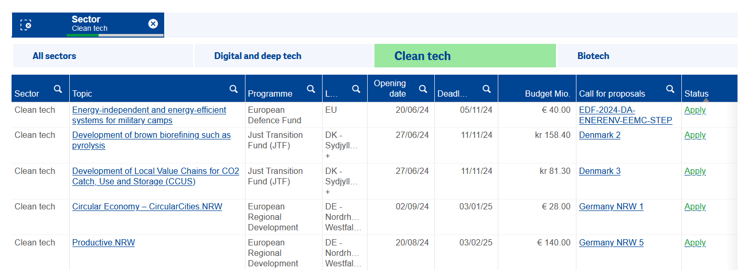
Launch of the STEP one stop shop

Slide 20
Opportunities
Call for evidence from the EC on the European Research Area – the new ERA 4 years on: achievements, lessons learnt and the way forward
Open until 30 September 2024
Consultation from ACER to gather inputs in order to formulate its opinion on the establishment of the new ‘European Network of Network Operators for Hydrogen’ (ENNOH)
Open until 21 October 2024
Notes:
In September 2020, the Commission adopted a Communication entitled ‘A new ERA for Research and Innovation’, describing a new vision for a stronger European Research Area (ERA) based on four priorities.
Four years on, the Commission intends to publish a new communication looking at the progress achieved in these areas and identifying the remaining challenges.
Agency for the Cooperation of Energy Regulators (ACER)

Slide 21
REPORTS & DATA

Slide 22
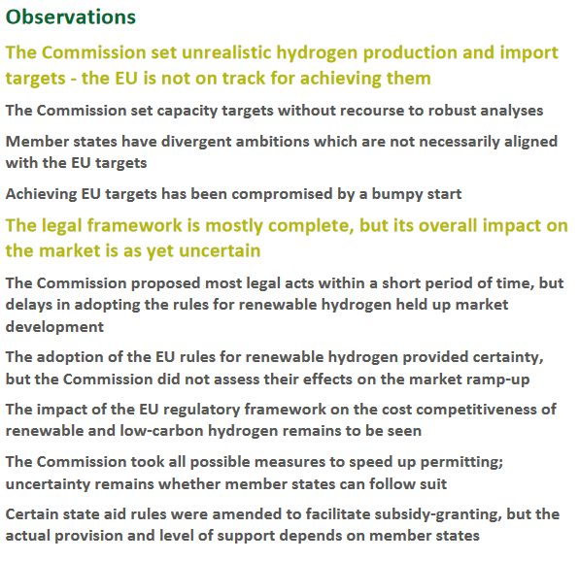
Publication of the ECA special report on Hydrogen
Publication of the report on July 2024 by the European Court of Auditors.
Notes:
the EU is unlikely to meet its 2030 targets for the production and import of renewable hydrogen (10Mt*2). These targets are deemed “unrealistic” by the Court of Auditors, which warns against strategic choices that could potentially harm the competitiveness of key industries or create new dependencies.
Point out that many investment decisions have been postponed, in particular because supply did not justify demand.
€18.8 billion for the 2021-2027 period earmarked for hydrogen projects is scattered across several programmes, which does not help companies to determine the most appropriate type of funding.
Call on the Commission to update its hydrogen strategy.
The auditors welcome the speed with which a framework providing the essential certainty for the establishment of a new market was established by the EC.
Details and timeline defined in the document, between 2025 and 2026.

Slide 23
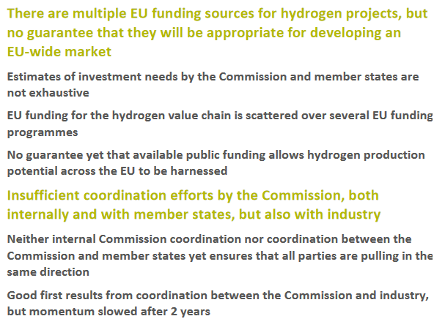
Publication of the ECA special report on Hydrogen
Recommendation 1 – Following a reality check, make strategic choices on the way ahead without creating new strategic dependencies
Recommendation 2 – Set out an EU roadmap and monitor progress
Recommendation 3 – Obtain reliable national funding data and assess the appropriateness of EU funding arrangements accordingly
Recommendation 4 – Monitor permitting processes in the member states
Recommendation 5 – Take a clear decision on support and coordination actions with and for the hydrogen industry
Notes:
The auditors welcome the speed with which a framework providing the essential certainty for the establishment of a new market was established by the EC.

Slide 24
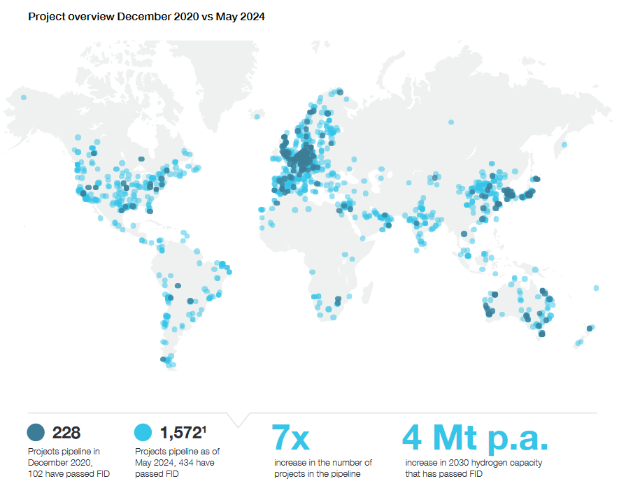
Hydrogen Insights 2024 – Hydrogen Council
Publication of the Hydrogen Insights 2024 by the Hydrogen Council & McKinsey on 18 September 2024.
X7 increase in committed capital for projects reaching FID, in 4 years.
2020: 228 projects with committed capital in 2020 May 2024: 1,572
Europe: number of projects has risen (124 to 600 in 4 years), but global share of projects has fallen (55% in 2020 to 40% in 2024), to the benefit of North America (20%), China (10%) and Latin America (10%).
Worldwide, investment in projects that have reached the FID stage has risen from around US$10 billion for 102 projects to US$75 billion for 434 projects in 4 years.
Problems specific to the sector remain: regulatory uncertainty, rising costs of renewable energy and electrolysers, which are causing delays in projects.
Notes:
According to the Hydrogen Council, this reflects the early stages of development in other clean energy sectors, such as wind and solar, “with natural attrition that fosters industry maturation by eliminating less viable projects and prioritising those with the highest potential”.

Slide 25
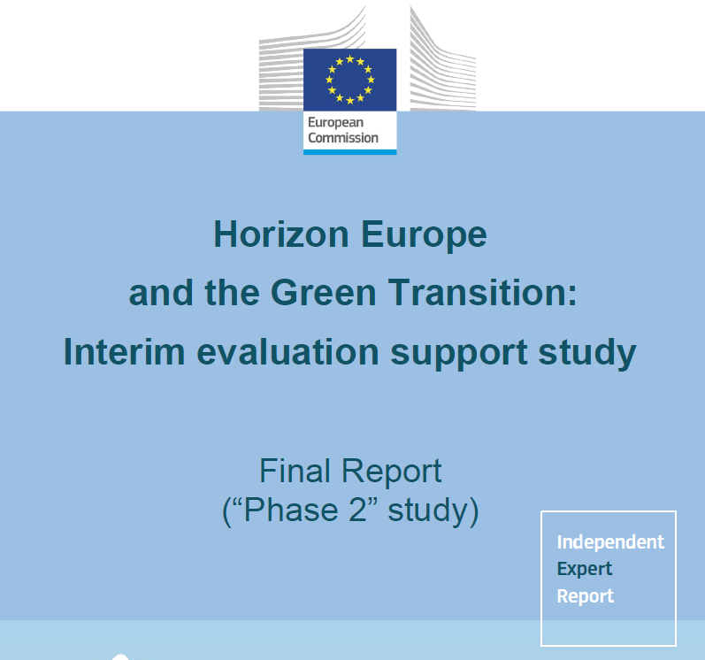
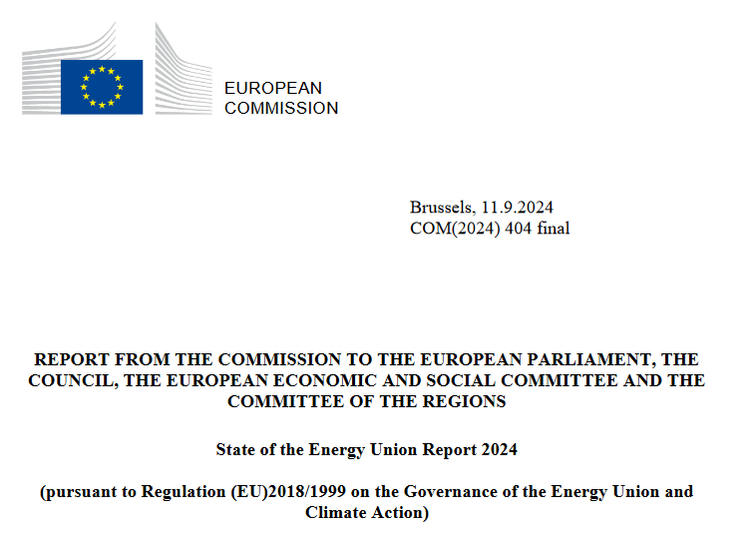
Other Reports
Interim report evaluation of Horizon Europe published
Input to the interim evaluation of Horizon Europe covering 2021-2023
Publication of the State of the Energy Union Report 2024

Slide 26
THANK YOU!
Avenue Marnix 23
1000 Brussels, Belgium
Next meeting to be scheduled:
25 October
https://hydrogeneuroperesearch.eu/

